Slide 1


L-4 Introduction to philosophy: definition, nature and scope, concept, branches
Research and Publication Ethics
Dr. Divya Singh
Designation- Associate Professor
divya.singh@mygyanvihar.com

Slide 2
Objective
. The students will understand Introduction to philosophy: definition, nature and scope, concept, branches

Slide 3
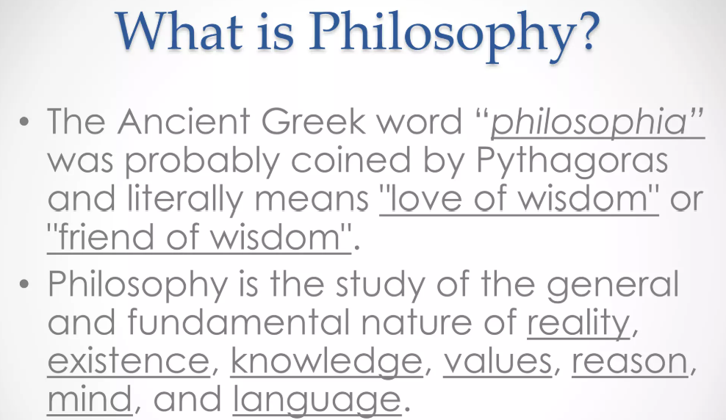

Slide 4
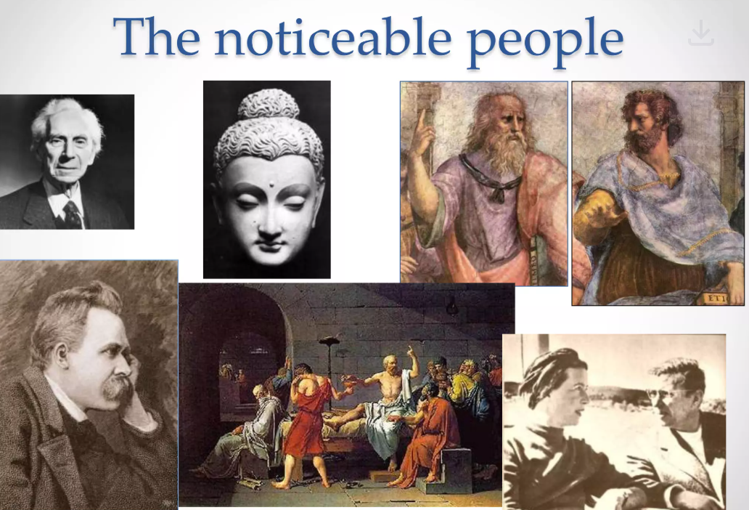

Slide 5
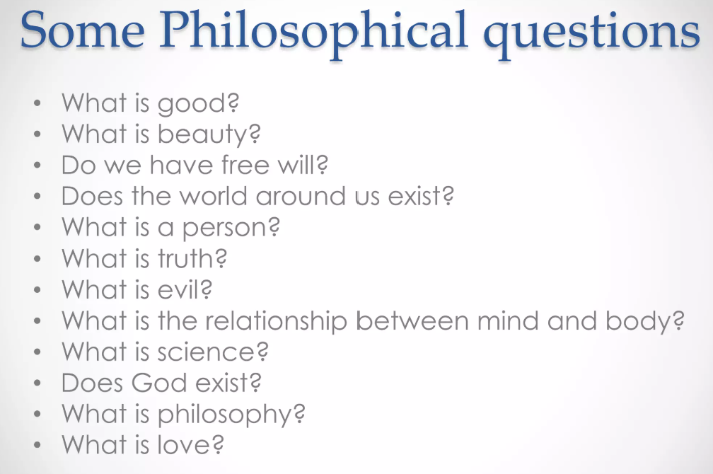

Slide 6


Slide 7


Slide 8



Slide 9



Slide 10


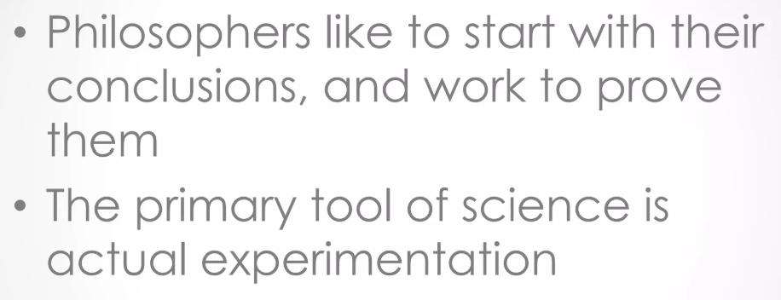

Slide 11


Slide 12



Slide 13
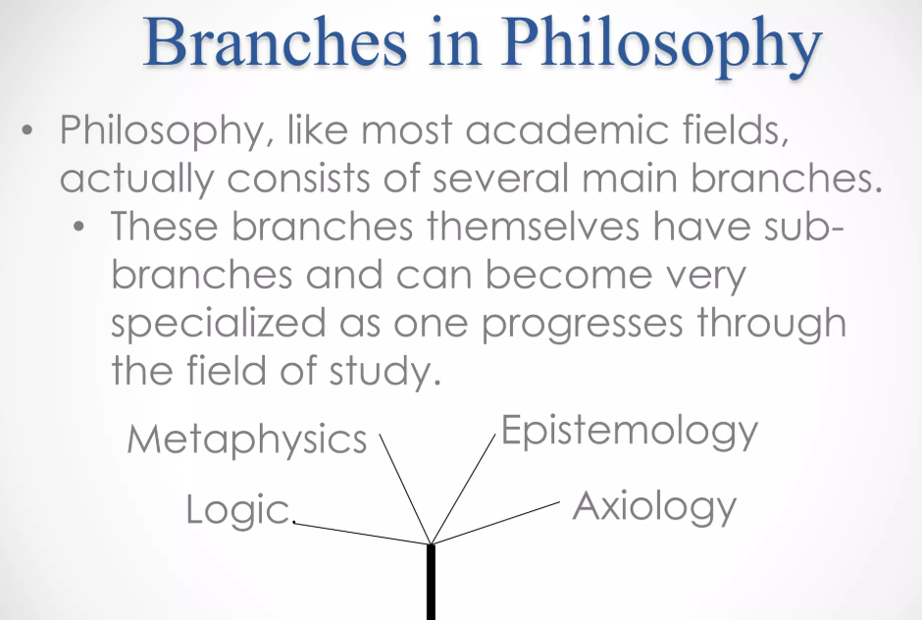


Slide 14
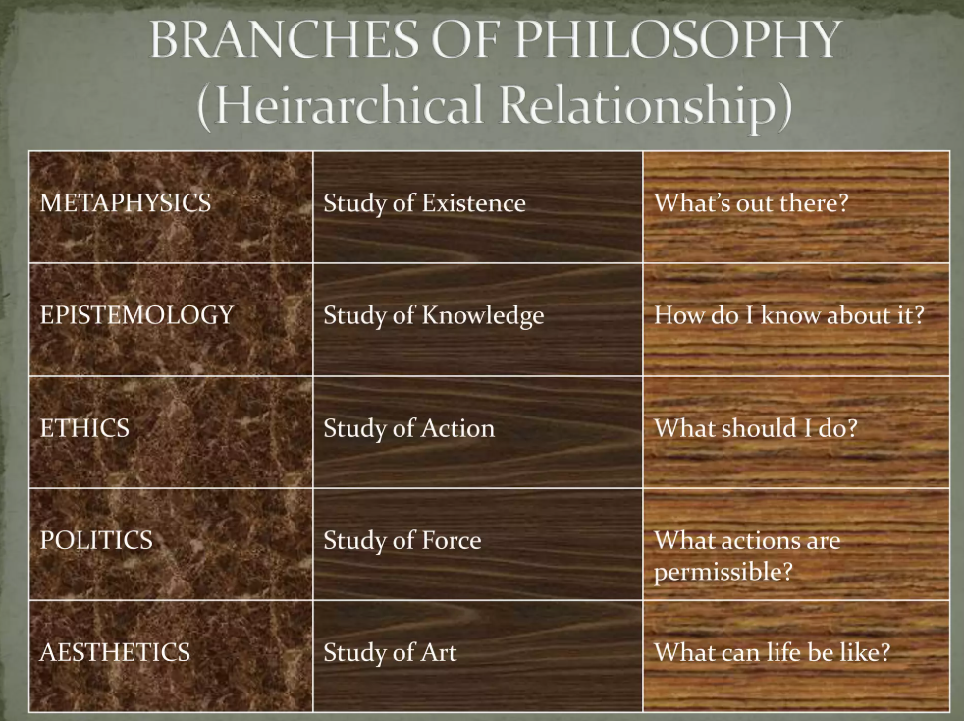

Slide 15
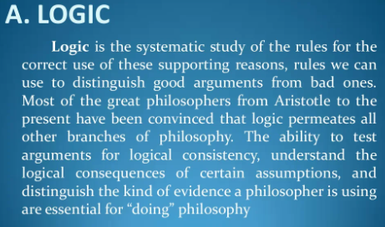

Slide 16


Slide 17


Slide 18


Slide 19


Slide 20


Slide 21


Slide 22
What is the primary focus of philosophy as a discipline?
A) Practical skills for daily life
B) Theoretical understanding of fundamental questions about existence, knowledge, and values
C) Technical proficiency in various sciences
D) Professional training for specific careers
Which of the following is NOT typically considered a branch of philosophy?
A) Metaphysics
B) Epistemology
C) Sociology
D) Ethics
What does 'metaphysics' primarily study in philosophy?
A) The nature of reality and existence
B) The principles of correct reasoning
C) The nature of knowledge and belief
D) The moral implications of human actions
Which branch of philosophy is concerned with the nature and scope of knowledge?
A) Ethics
B) Aesthetics
C) Epistemology
D) Logic
In philosophy, what does 'ethics' study?
A) The nature of beauty and art
B) The principles of valid reasoning
C) The nature of moral values and principles
D) The nature of reality and existence

Slide 23
Which branch of philosophy deals with questions of beauty and artistic expression?
A) Metaphysics
B) Epistemology
C) Ethics
D) Aesthetics
What is 'logic' concerned with in the context of philosophy?
A) The study of moral values
B) The nature of reality and existence
C) The principles of valid reasoning and argumentation
D) The nature of beauty and artistic expression
Which of the following is a key concept in metaphysics?
A) Knowledge
B) Morality
C) Existence
D) Art
What does the term 'philosophy' derive from?
A) Latin for 'wisdom'
B) Greek for 'love of wisdom'
C) French for 'study of logic'
D) German for 'science of being

Slide 24
Which branch of philosophy investigates the nature of logical systems and arguments?
A) Epistemology
B) Ethics
C) Logic
D) Metaphysics
What is the scope of philosophy?
A) Limited to specific practical applications
B) Restricted to empirical sciences only
C) Encompassing broad and abstract questions about life, existence, and knowledge
D) Focused solely on historical texts and traditions
Which branch of philosophy investigates the nature of logical systems and arguments?
A) Epistemology
B) Ethics
C) Logic
D) Metaphysics
What is the scope of philosophy?
A) Limited to specific practical applications
B) Restricted to empirical sciences only
C) Encompassing broad and abstract questions about life, existence, and knowledge
D) Focused solely on historical texts and traditions

Slide 25
Which branch of philosophy explores the nature of human conduct and moral values?
A) Metaphysics
B) Ethics
C) Logic
D) Aesthetics
Answer: B) Ethics
Which of the following questions is a typical concern of philosophy?
A) How to achieve a specific career goal
B) What is the nature of justice?
C) How to use a particular software tool
D) What are the latest scientific discoveries?

Slide 26



